Slide 1
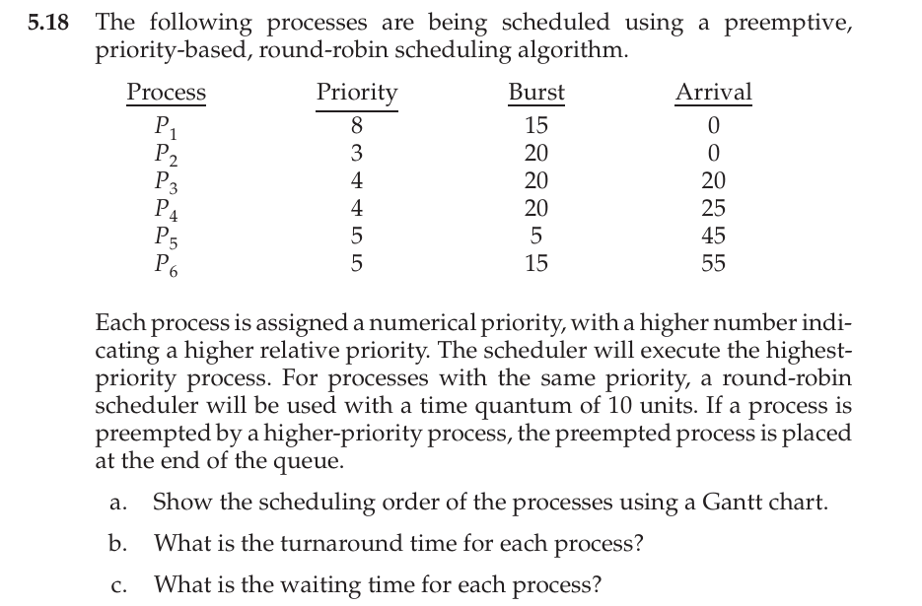

Slide 2
Ready queue | p1 |  |  | p2 |  |  | p3 |  |  | p2 |  |  | p4 |  |  | p3 |  |  | p4 |  |  | p5 |  |  | p3 |  |  | p6
Gantt chart | p1 |  |  | p2 |  |  | p3 |  |  | p4 |  |  | p3 |  |  | p5 |  |  | p3 |  |  | p6 |  |  | p4 |  |  | p2
time | 0 |  | 15 |  |  | 20 |  |  | 30 |  |  | 40 |  |  | 45 |  |  | 50 |  |  | 55 |  |  | 70 |  |  | 80 |  |  | 95
10
10
10
10
10
10
10
10
10
10
Process | Priority | Burst | AT Arrival time | CT Complete time | TAT Turn around time (CT - AT) | WT waiting time (TAT -BT)
p1 | 8 | 15 | 0 | 15 | 15 | 0
p2 | 3 | 20 15 0 | 0 | 95 | 95 | 75
p3 | 4 | 20 10 5 0 | 20 | 55 | 35 | 15
p4 | 4 | 20 10 0 | 25 | 80 | 55 | 35
p5 | 5 | 5 | 45 | 50 | 5 | 0
p6 | 5 | 15 | 55 | 70 | 15 | 0

